Slide 1

TRAVEL
ASSISTANT

Slide 2

ALEENA AFTAB
(F2019065227)
EHSAN ALI
(F2019065021)
Advisor Name
Sir ,Amjad .H. Zahid

Slide 3
AGENDA:
Introduction
Technologies
Functional And Non-Functional Requirements
Hardware Requirement

Slide 4
INTRODUCTION
A Travel management system helps to travel managers book, track and analyze business travels.Typically,it also refers to as a plat form that offers travels inventory ,travel booking, and reporting, but it can also refers to the overall process of managing cooperate travel

Slide 5
Technologies
HTML
PHP

Slide 6
FUNCTIONAL REQUIREMENTS :
Admin Requirement (The admin can add new package).
End User Requirement (The end users can book tour plan according to their choice).
System Requirement (Travel management system offer logout offer logout functionality to end users).

Slide 7

NON-FUNCTIONAL REQUIRMENTS :
Following are the non-functional requirements:
Reservations Requirement (It should reserve a travel package in maximum 30 to weekly by evaluation of the project guide).
Usability Requirement (In PHP is designed for user friendly environment and ease of use )
Efficiency Requirement (When an online package of travel implemented can have reserved packages in an efficient manner).

Slide 8
HARDWARE REQUIREMENTS :
Following are the hardware requirements:
RAM:
Minimum 1 GB RAM required for the system.
Processor:
Intel core 1.5 GHz.
Operating System :
All windows.

Slide 9
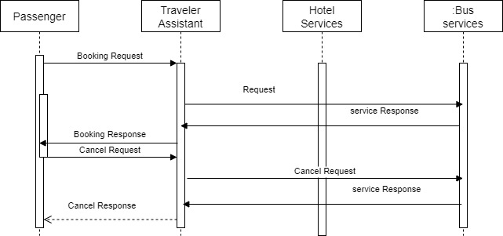
Sequence Diagram

Slide 10
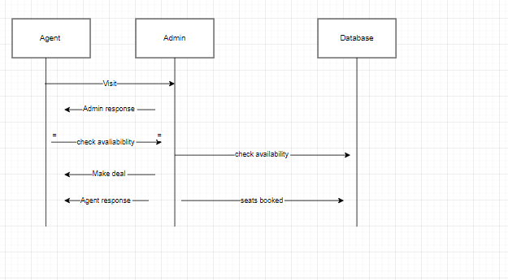
Sequence Diagram

Slide 11
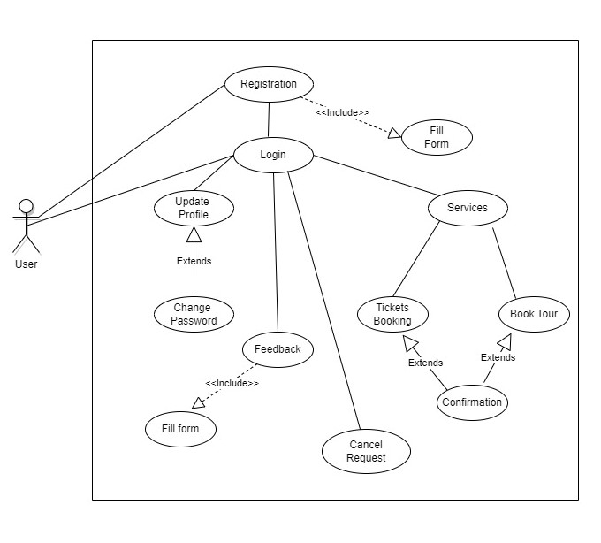
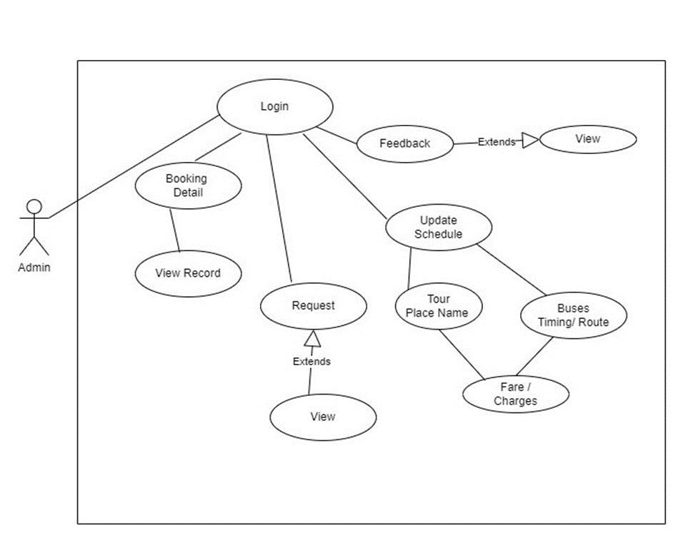
USE Case Diagram

Slide 12
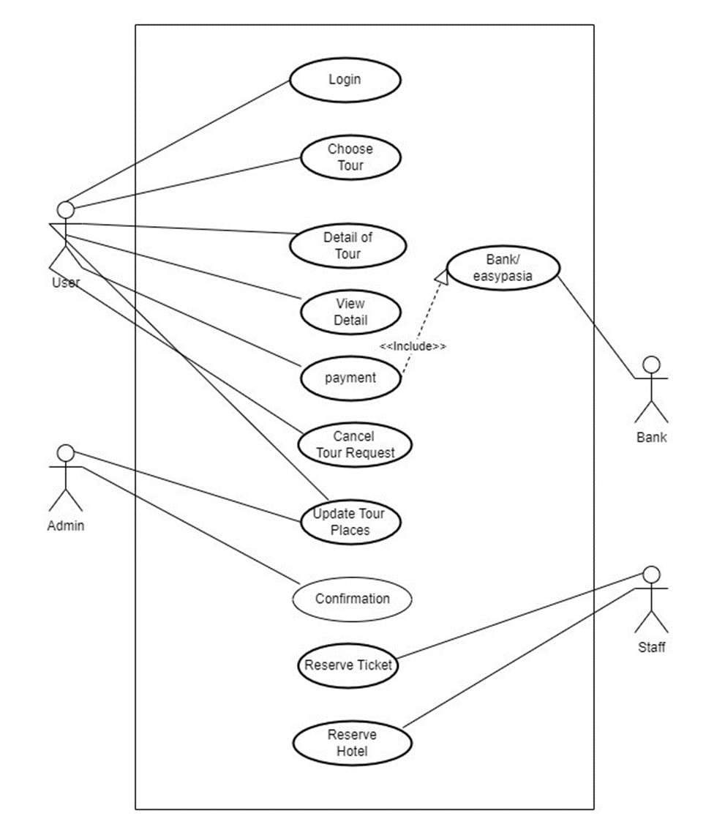
Use Case Diagram

Slide 13
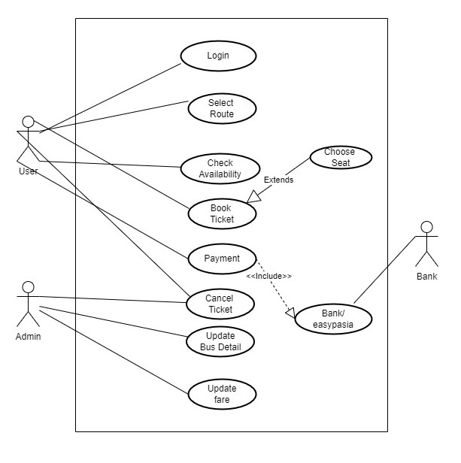
Use case Diagram

Slide 14


